Slide 1
Web Development
Prepared by: Nikko Dela Cruz

Slide 2
What you’ll learn
jQuery
AJAX
Essential Tools/Materials for Frontend Development (Open Soure)
Overview of Wordpress (CMS)

Slide 3
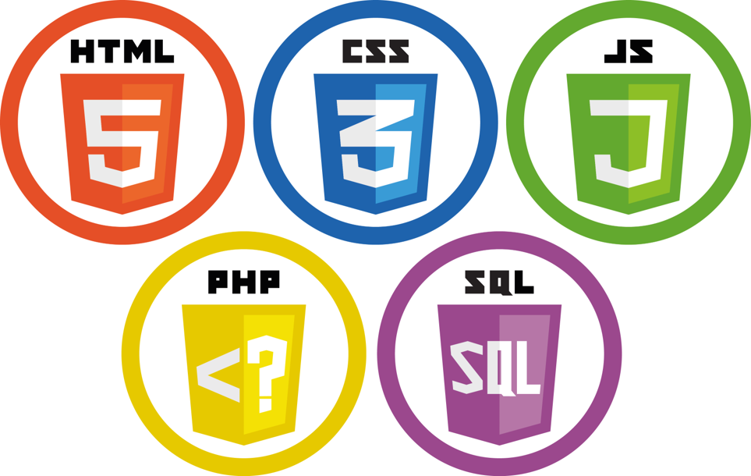

Slide 4
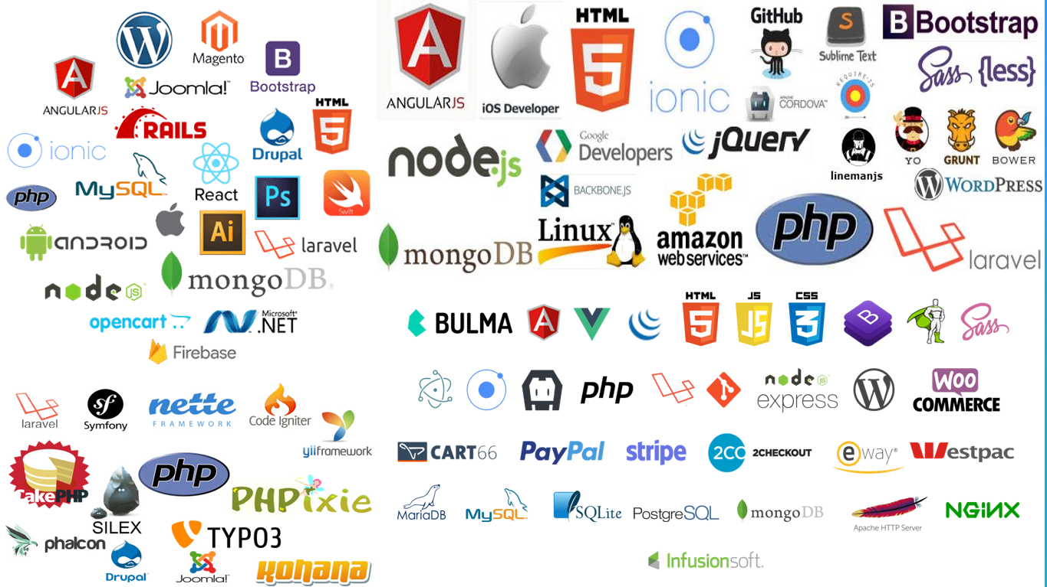
Web Frameworks
Designed to support the development of web applications
Provide tools and libraries to simplify common web development operations.
For faster development

Slide 5
Types Of Websites
E-commerce website (Lazada, Shoppe, Amazon, ebay, Alibaba)
Social networking site (Facebook, Instagram, Twitter, YouTube)
News website (CNN, GMA news online, Philippine Daily Inquirer)
Corporate website
Blog, Portfolio, Web portal (BulSU Web Portal)
and so much more

Slide 6
JQuery (Javascript Query)
HTML
CSS
Javascript
Small, fast, and feature-rich JavaScript library
Short syntax (elements, value, attributes)
Event methods (click, hover, ready)
Effects & Animations

Slide 7
AJAX (Asynchronous JavaScript And XML)
Update a web page without reloading the page
Request data from a server - after the page has loaded
Receive data from a server - after the page has loaded
Send data to a server - in the background

Slide 8
CMS (Content Management System)
A software application that can be used to manage the creation and modification of digital content.
Wordpress, Drupal, Joomla, Magento (e-commerce), Shopify (e-commerce)
Wordpress
Allows the users to build dynamic websites and blogs.
Most popular blogging system on the web and allows updating, customizing and managing the website from its back-end and components.
PHP and MySQL

Slide 9
“The greatest successes come from having the freedom to fail.” - Mark Zuckerberg

Slide 10
Thank you and God bless ☺

